Slide 1

Lifelong Learning • Professional Development • Personal Enrichment

Slide 2

Who We Are
Vision
“The University of North Florida, Division of Continuing Education aspires
to be the unrivaled regional provider of professional development, lifelong learning opportunities and customized corporate services that drive economic development and individual success.”
Mission
“The University of North Florida, Division of Continuing Education offers unparalleled education and training programs that: the Community selects for personal enrichment; Professionals prefer for career advancement; Employers recommend to associates; and, Companies seek for long-term success.”

Slide 3
Strategic Framework
2018 – 2024 Goals
Strengthen and broaden relationships with partners and stakeholders
Evaluate and advance programs and courses annually
Continuously sharpen market outreach
Utilize innovative technology and data management systems
Increase operating and advancement revenue annually

Slide 4

Unparalleled Workforce Development
Serving Professionals & Employers:
Leadership
Finance
Logistics
Quality & Process
Informational Technology
And more
Offerings in “Executive Format”
Collaborating to Provide Corporate Training
Emphasis on customized training solutions
Notes:
UNF DCE’s Professional Development department’s goal is to be recognized as THE place to go in northeast Florida for continuing education and professional development. We do this by offering classes in a variety of topics and formats. Specifically, the majority of our course offerings are delivered in an executive format that is presented during night and weekend hours so the working professional can attend. We are also providing online formats to allow the increased flexibility of a self-paced, start anytime program that is even more accommodating to the working professional.
It’s important to note that we work with our local CareerSource office to understand what our regional occupational demands are so we can ensure our program portfolio is meeting the need in our area. We also emphasize our ability to customize any program to meet a company’s need and even work with them to obtain state grants.
The wonderful thing about our department is that we are able to provide an avenue for individuals to still have a connection with UNF, even if they are not alumni. It is our vision that not only are these individuals referring our non-credit programs to their colleagues, but they are also considering UNF as an impressive school to enroll their children.
FACT INFO FOR POTENTIAL QUESTIONS:
More than 20 open enrollment programs, 5 of which are delivered in an online format (Ranging from $200 - $6,000)
Several open enrollment program in development:
Learning Design Certificate (Registration anticipated in Summer 2019)
Animal Assisted Therapy in Counseling Certificate (Registration anticipated in Summer 2019)
Executive Leadership Development Program (Registration anticipated in Fall 2019)
Numerous ongoing customized corporate course offerings/partnerships
SJC New Supervisor Series
SJC Existing Supervisor Series
SJC Leadership Academy
Jax Beach Leadership Academy
DCMS Leadership Academy
FCMA Leadership Academy
Kraton Yellow Belt (online)
Northrop Grumman PMC
Operation New Hope Logistics Program
Florida Blue Leadership Development Program

Slide 5

Innovate DCE
External
PNC Bank
Jax Chamber / JAXUSA
First Coast Manufacturing Association
Duval County Medical Society
Internal
Brooks College of Health
Coggin College of Business
Notes:
UNF DCE’s Professional Development department’s goal is to be recognized as THE place to go in northeast Florida for continuing education and professional development. We do this by offering classes in a variety of topics and formats. Specifically, the majority of our course offerings are delivered in an executive format that is presented during night and weekend hours so the working professional can attend. We are also providing online formats to allow the increased flexibility of a self-paced, start anytime program that is even more accommodating to the working professional.
It’s important to note that we work with our local CareerSource office to understand what our regional occupational demands are so we can ensure our program portfolio is meeting the need in our area. We also emphasize our ability to customize any program to meet a company’s need and even work with them to obtain state grants.
The wonderful thing about our department is that we are able to provide an avenue for individuals to still have a connection with UNF, even if they are not alumni. It is our vision that not only are these individuals referring our non-credit programs to their colleagues, but they are also considering UNF as an impressive school to enroll their children.
FACT INFO FOR POTENTIAL QUESTIONS:
More than 20 open enrollment programs, 5 of which are delivered in an online format (Ranging from $200 - $6,000)
Several open enrollment program in development:
Learning Design Certificate (Registration anticipated in Summer 2019)
Animal Assisted Therapy in Counseling Certificate (Registration anticipated in Summer 2019)
Executive Leadership Development Program (Registration anticipated in Fall 2019)
Numerous ongoing customized corporate course offerings/partnerships
SJC New Supervisor Series
SJC Existing Supervisor Series
SJC Leadership Academy
Jax Beach Leadership Academy
DCMS Leadership Academy
FCMA Leadership Academy
Kraton Yellow Belt (online)
Northrop Grumman PMC
Operation New Hope Logistics Program
Florida Blue Leadership Development Program

Slide 6

Your schedule. Your budget. Your future… today!
Partnering with Ed2Go
Advanced Career Training
Fundamentals
‘Certification’ gap
Expanding our DCE Course Offerings
Increasing Market Share
MyCAA
Notes:
Our partnership with Ed2Go allows us to provide more than 800 online courses to our market share. There are two types of courses that are provided through Ed2Go: the career training programs, which prepare an individual to earn a nationally recognized certification, and the fundamentals courses which assist with learning a new skill or enhancing an existing one. Currently, DCE focuses on the career training programs as they fill a “certification” gap that exists in our division. Eventually we would like to leverage the Fundamentals courses in a more strategic manner to establish prerequisites and/or recommend other courses as “feeder” courses into both our open enrollment programs and the career training programs.
One of the many benefits of our partnership with Ed2Go is that we are easily able to expand our course offerings without exhausting our in-house resources. As a small department with a limited budget, we are able to capitalize on the extensive variety of nationally recognized certifications and only “pay for what we use” rather than investing a large sum and waiting for the ROI.
An initiative we are currently working through is bringing more awareness of our online programs to military families as they are the perfect fit for MyCAA funding, which is the military spouse’s education benefit.
FACT INFO FOR POTENTIAL QUESTIONS:
564 Fundamentals courses (mostly at the $129 price point)
Accounting & Finance
Business
College Readiness
Computer Applications
Design & Composition
Healthcare & Medical
Language & Arts
Law & Legal
Personal Development
Teaching & Education
Technology
Writing & Publishing
325 Career Training Programs (Range from $600 - $6,000)
Arts & Design
Business
Career Online High School
Computer Applications
Computer Programming
Construction and Trades
Health and Fitness
Hospitality
Information Technology
Language
Legal
Teacher Professional Development
Writing

Slide 7

Take a class for the fun of it!
Discover a New Hobby or Gain a New Skill
Money Matters, Language, Arts and Crafts, Photography, and more
70+ unique classes each term / ~50 instructors
Area Partnerships
Explore New Topics and Classes
Back to Basics: natural skills for sustainability Money Matters: aimed at millennials
Summer Camps – Coming Soon!

Slide 8

Be Prepared!
Get Your Higher Score, Faster
Undergraduate: ACT and SAT
Graduate: GMAT, GRE, MCAT, LSAT
In-person and online
Exceptional Preparation – Affordable Price
Collaborating with area high schools, Enrollment Services, UNF Graduate Schools
Exploring new vendor options

Slide 9

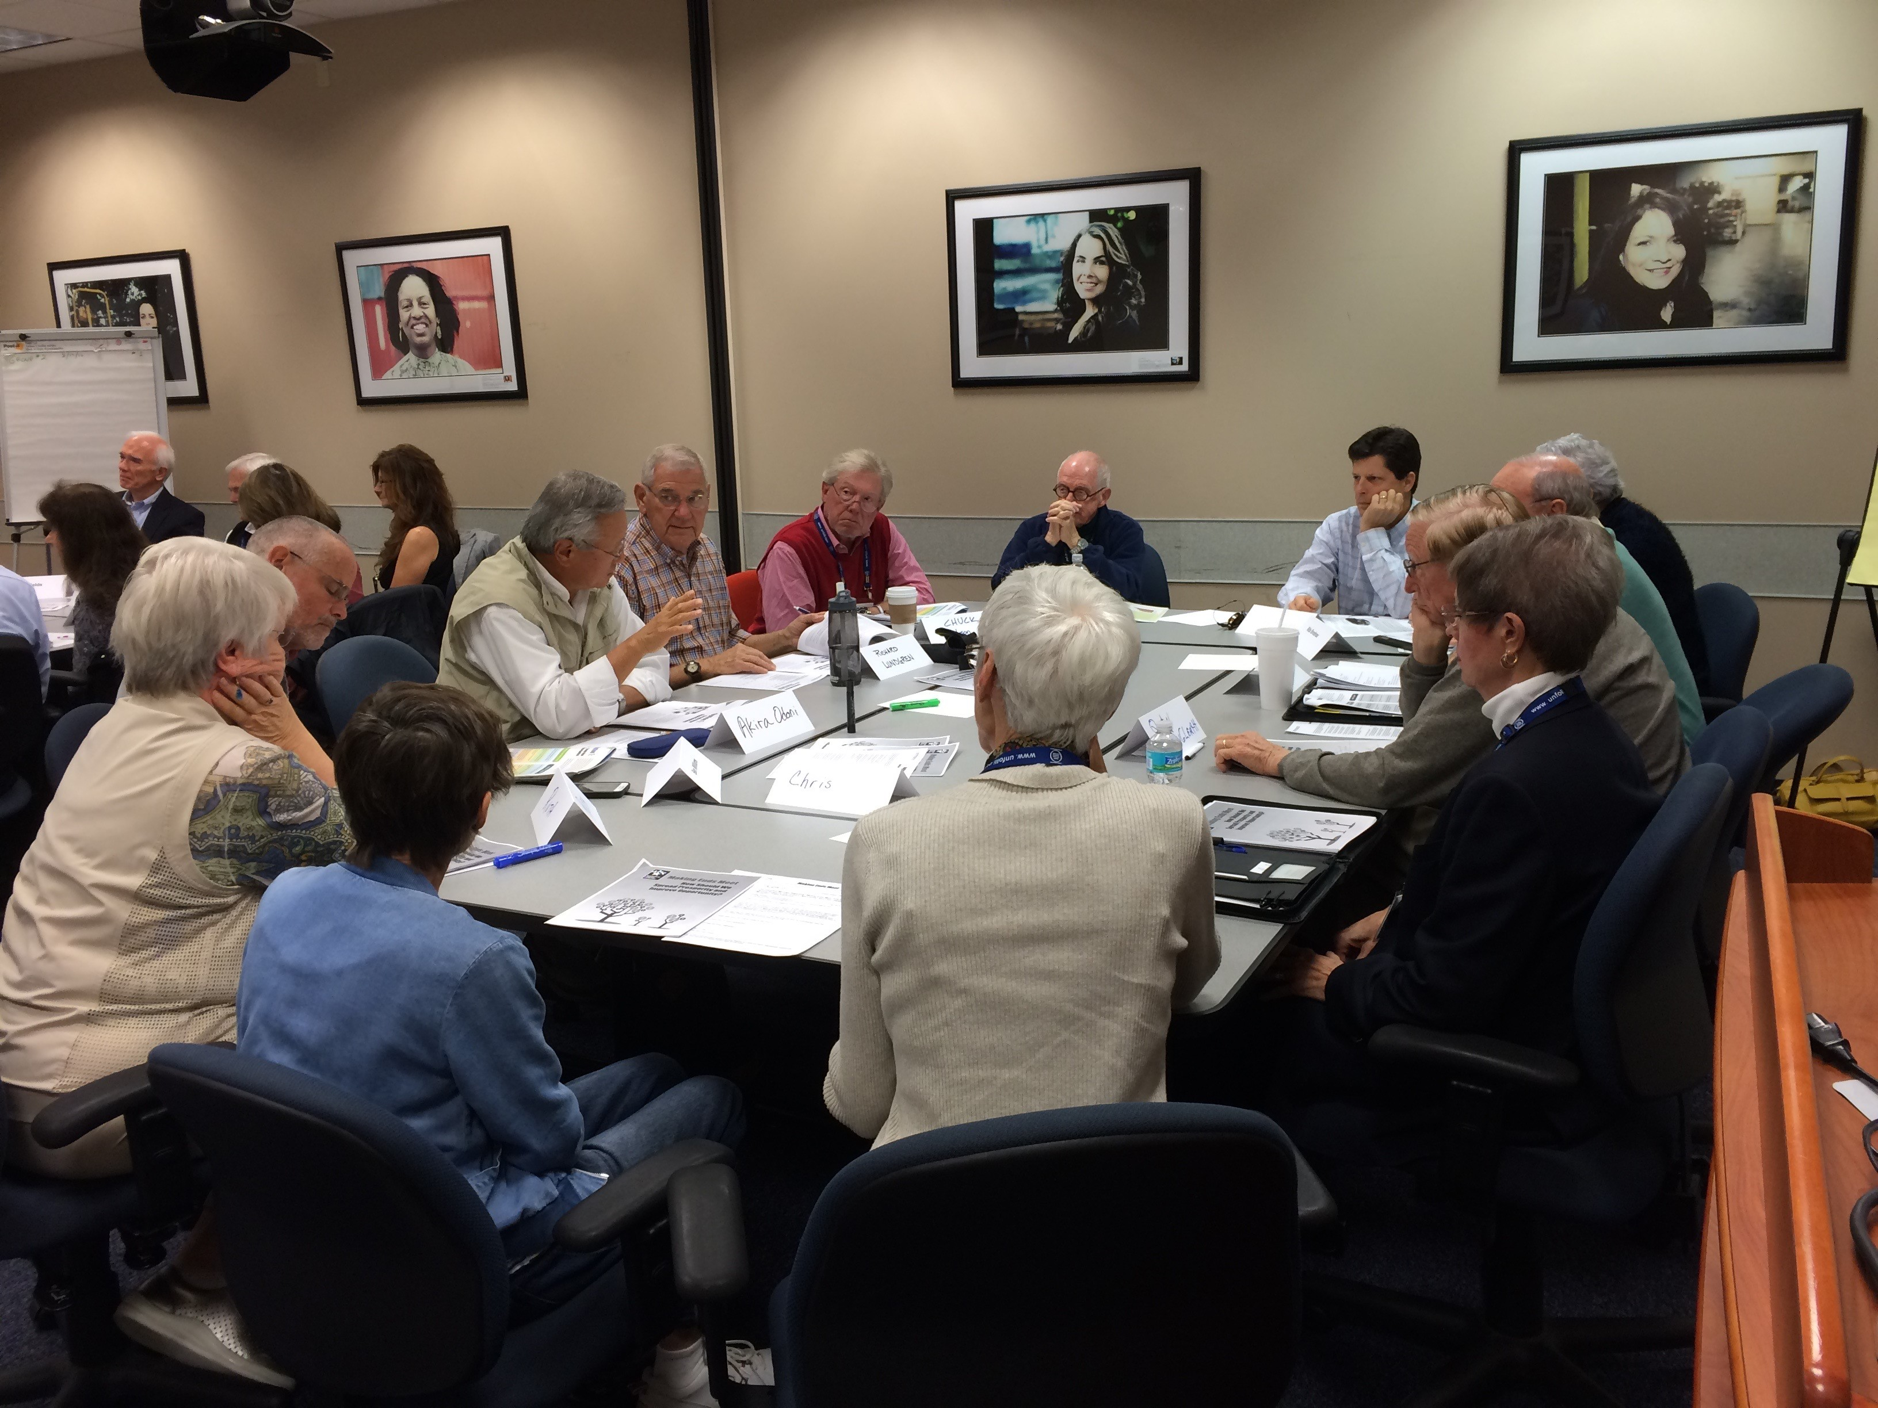
Live Well. Learn Forever.
Lifelong Learning for Those Age 50 and Better
High volume, high novelty programs
Member association
Volunteer organization
Fundraising entity
Future Plans
Maintain bellwether status in national network
Innovate | implement opportunities for UNF students
Enhance volunteer leadership development
Prepare for Gen X, Y & Z members

Slide 10
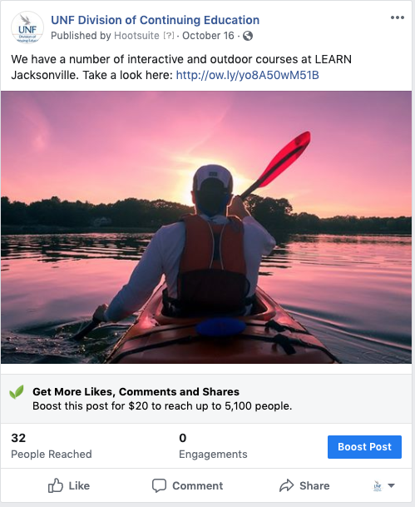
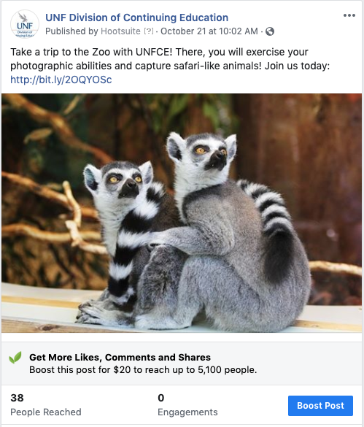
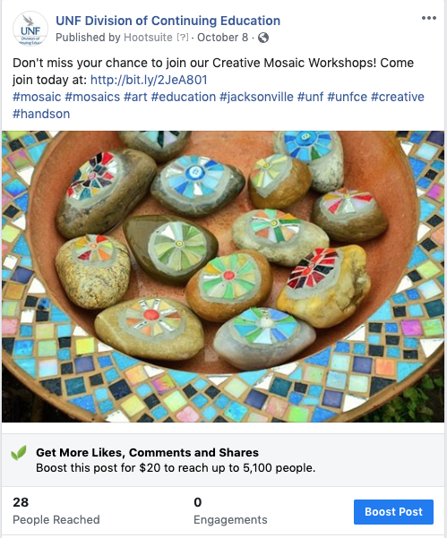

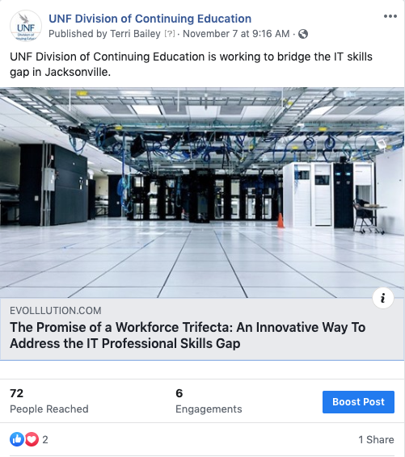
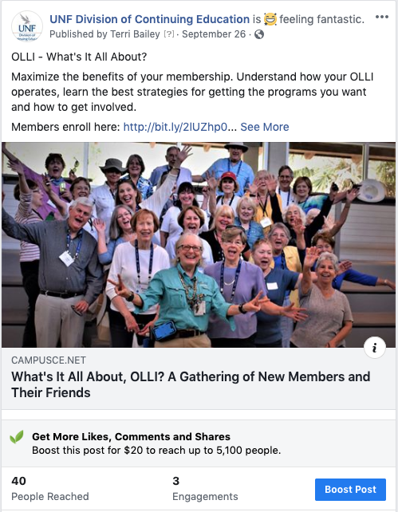
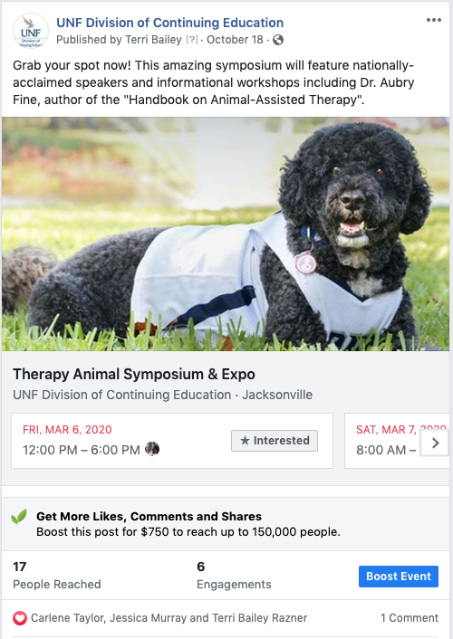
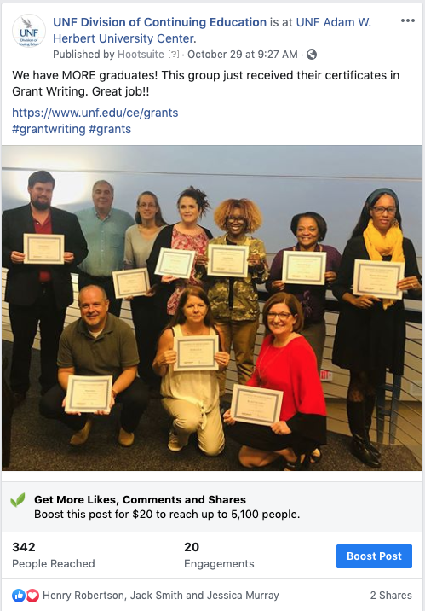
e-Communication Social Networking

Slide 11

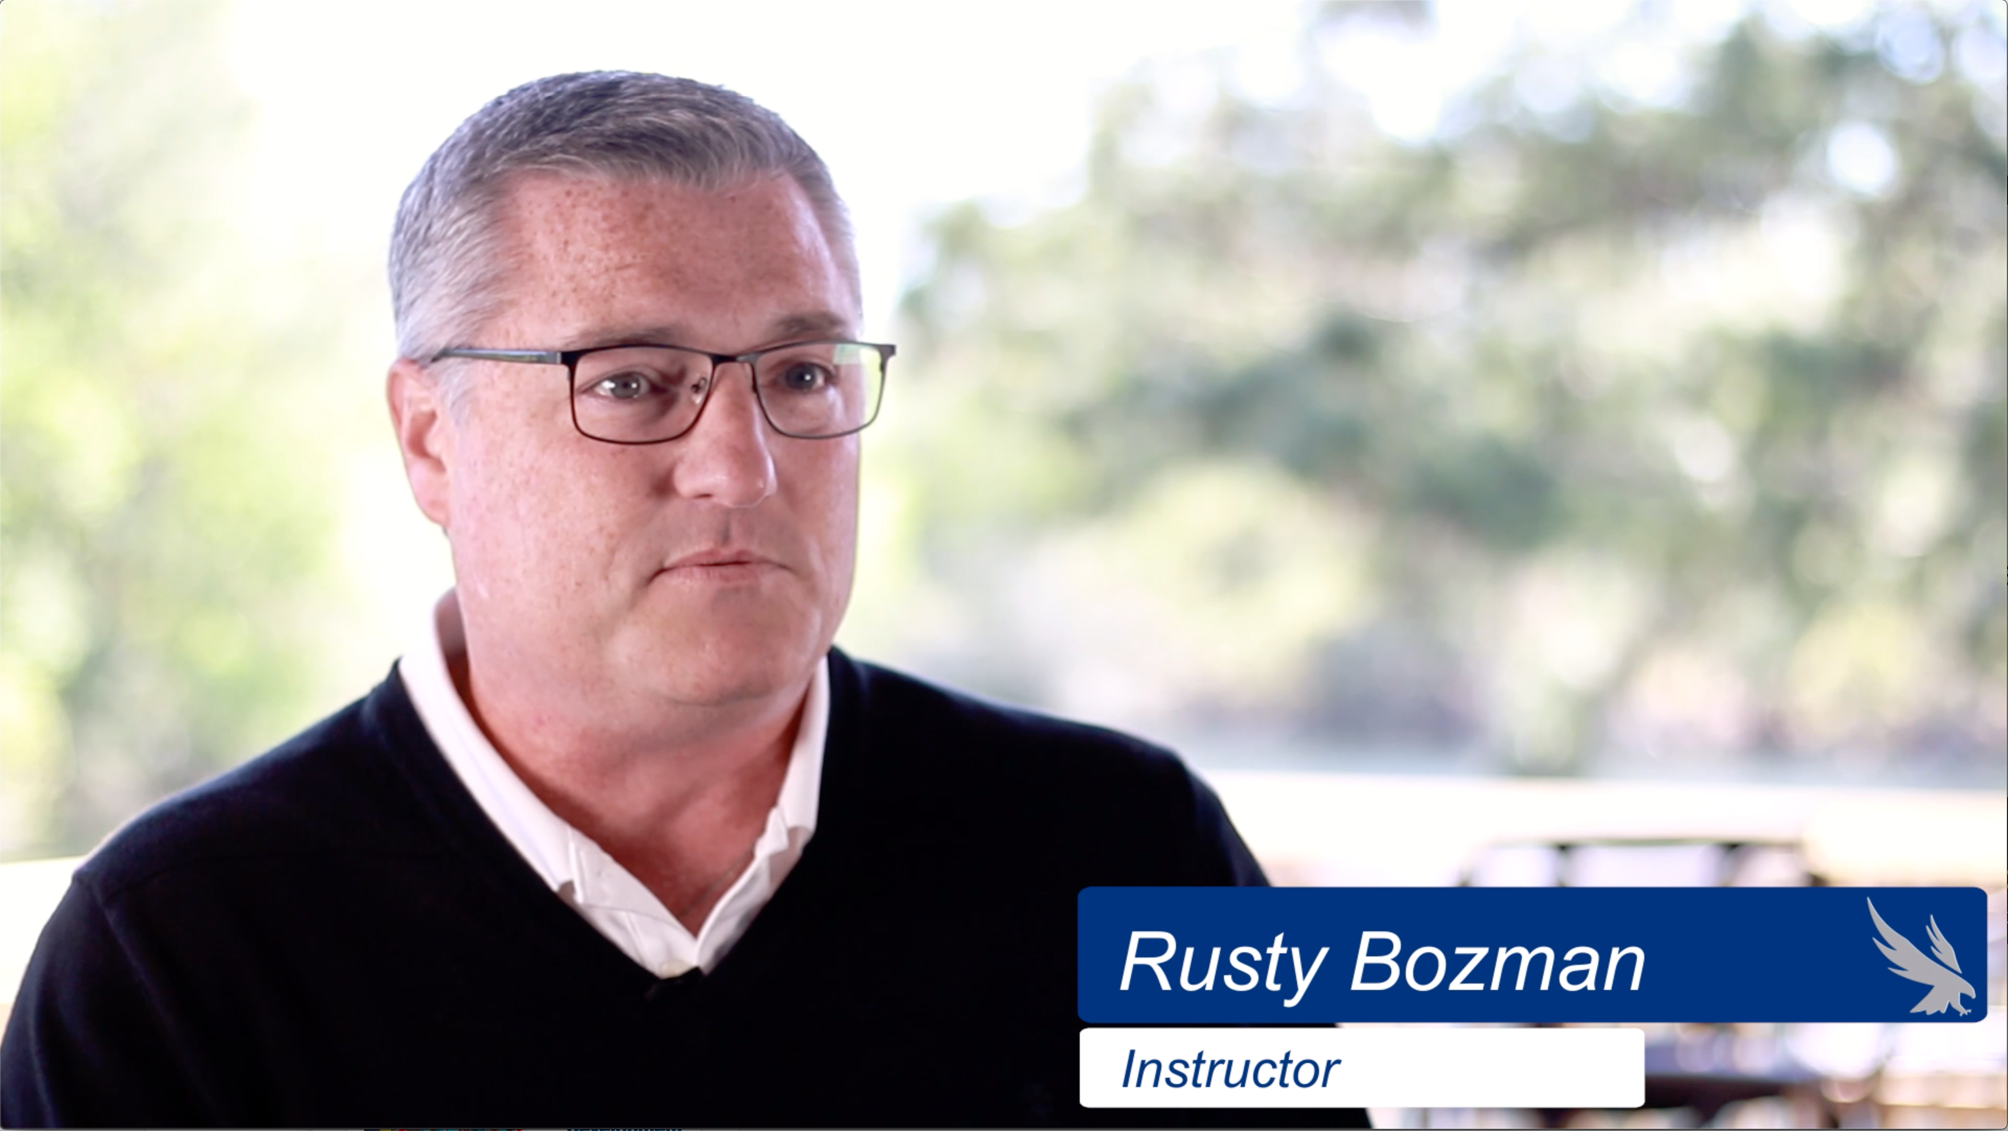
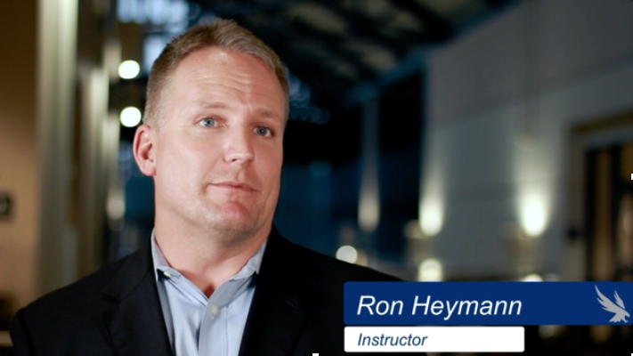
Digital Marketing Video Campaign
Project Management
New Manager Essentials
Lean Six Sigma
Certified Financial Planner™

Slide 12


e-Communication Professional Development
• Sent monthly
• One featured program • 30% Open Rate
(10-15% is average)
• 10% Click Rate
(6% is average)
*Stats are based on PD program

Slide 13
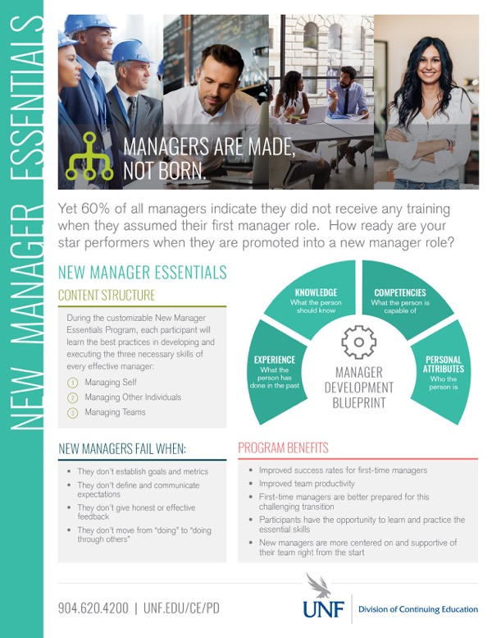

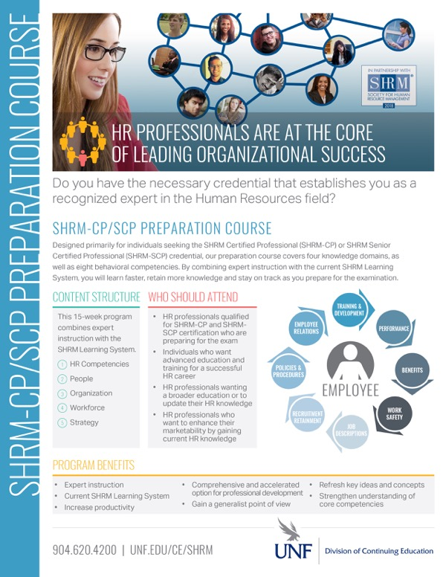


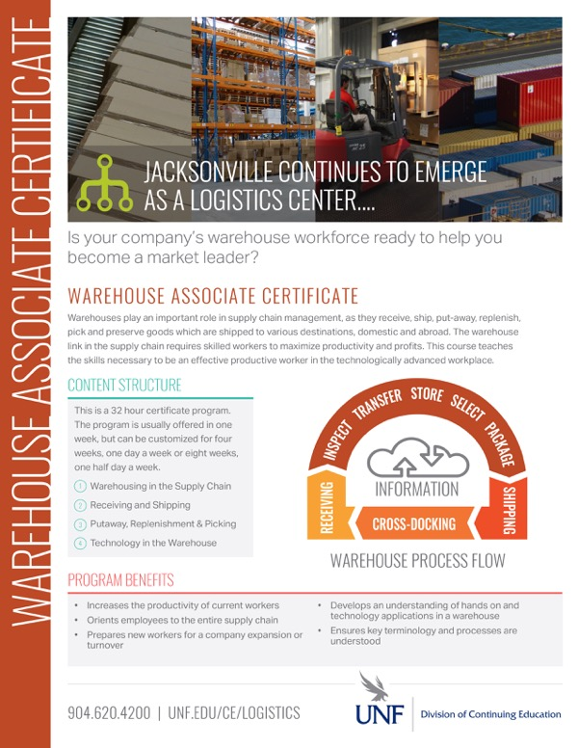
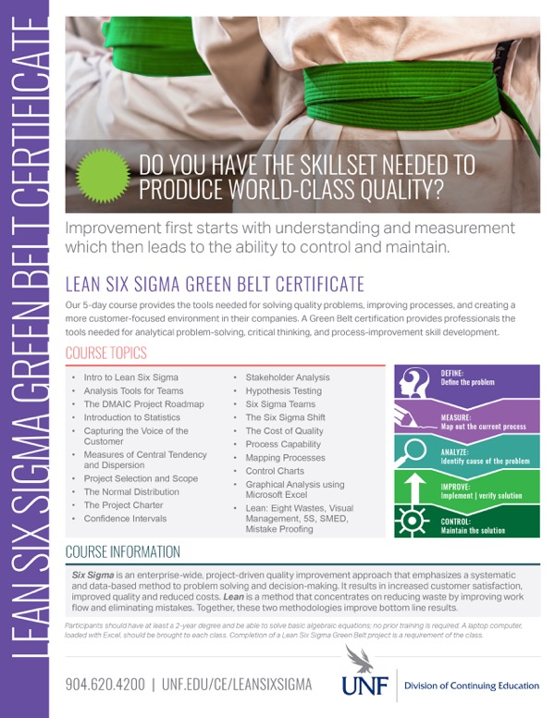

Print Communication Professional Development Flyers
Also Utilized:
• Catalogs
• Journal Ads
• Postcards

Slide 14
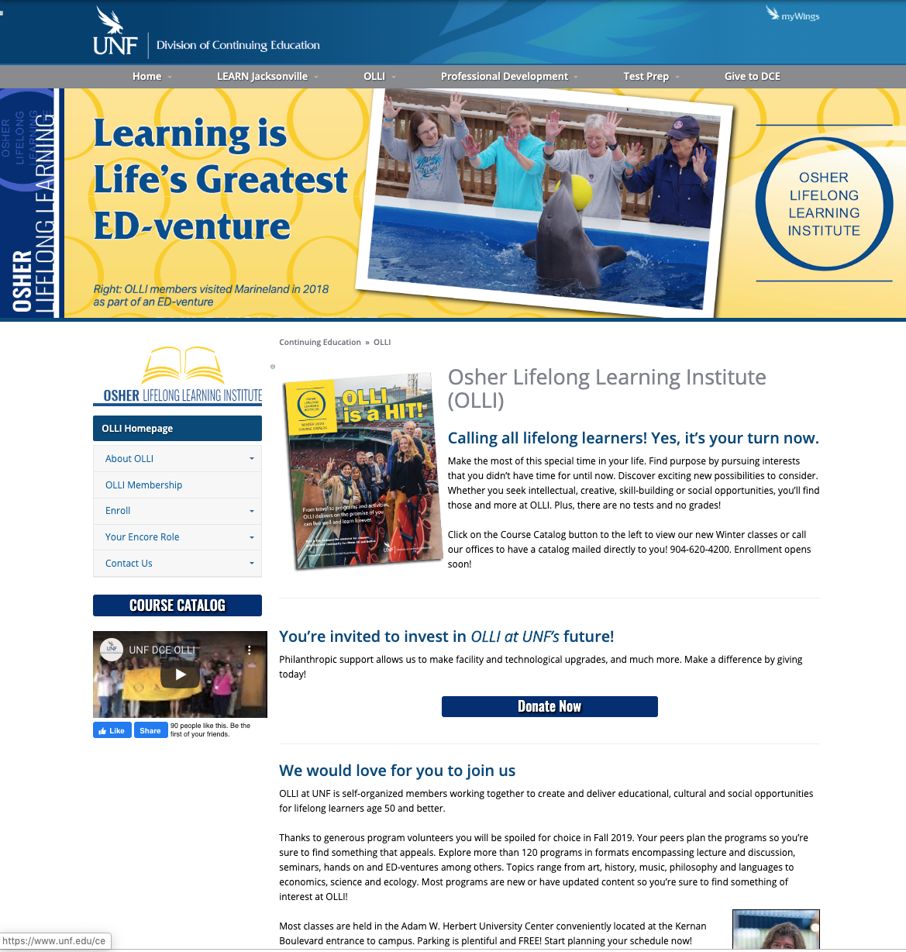
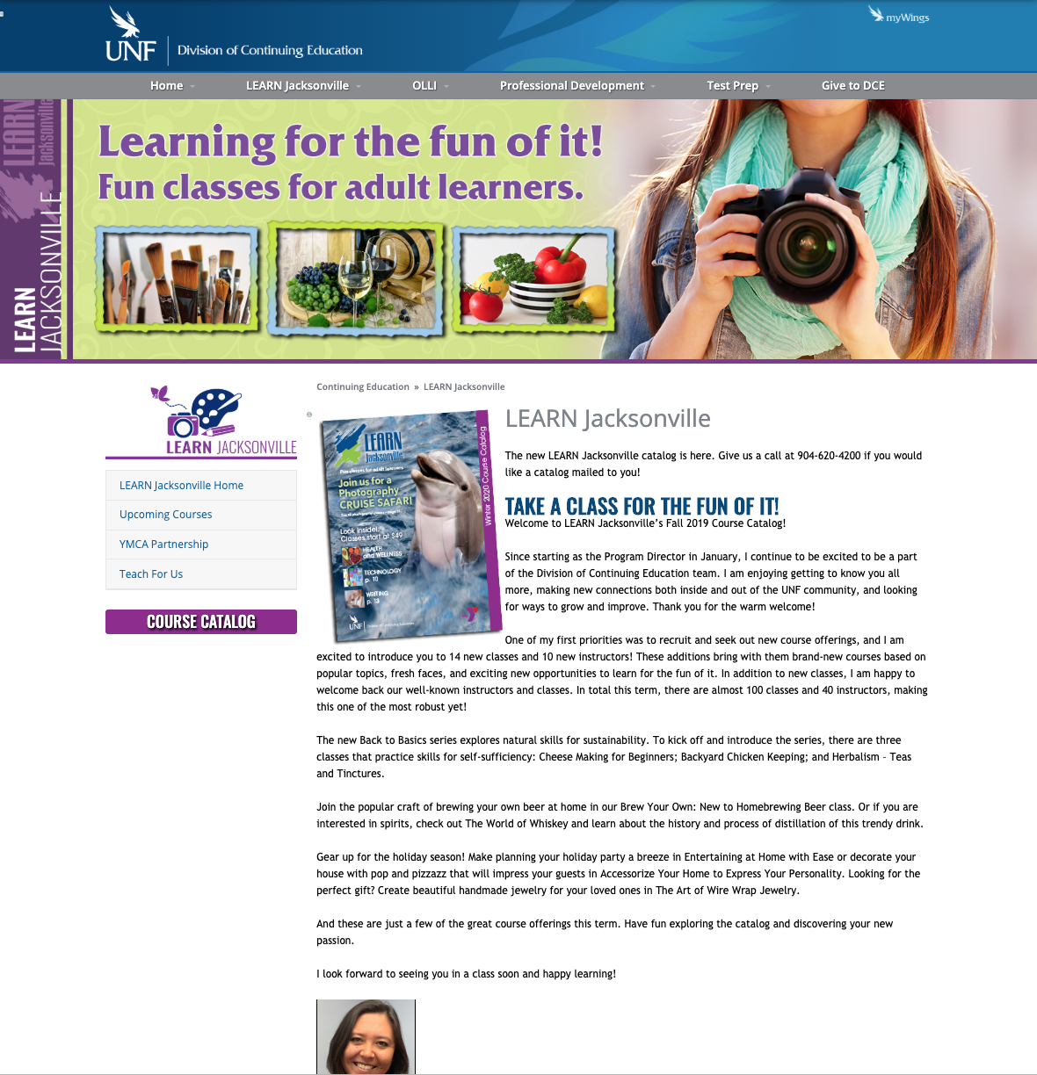
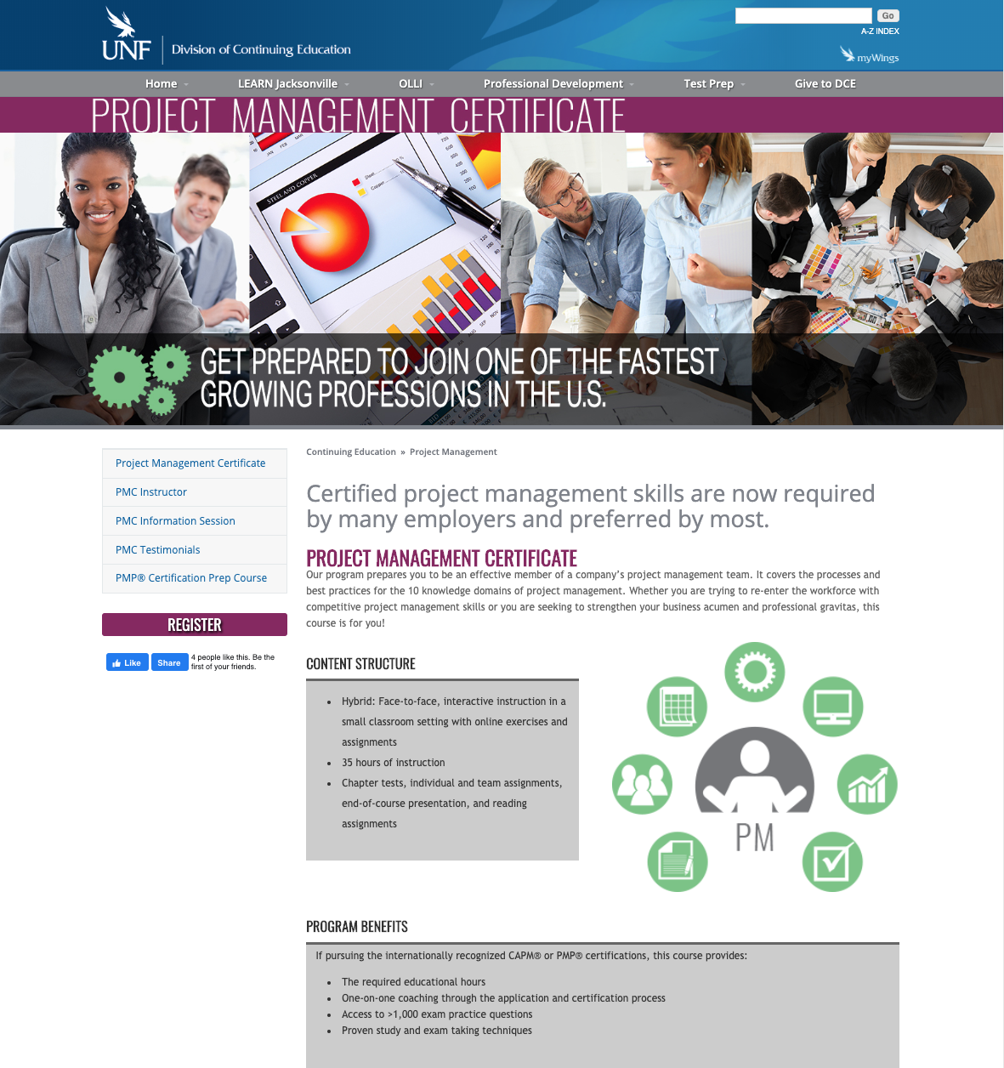
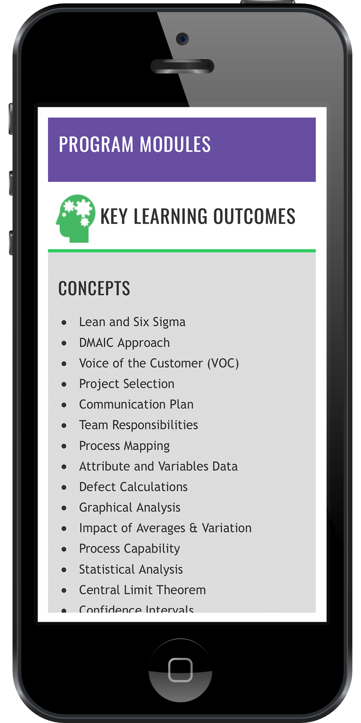
Program Webpages
OLLI
LEARN Jacksonville
PD Program – Project Management

Slide 15
Our Financial Health

Slide 16


Where We’ve Been. Where We’re Going.
Auxiliary
Historical
Perspective
FY08 – FY16 budgets in the red
$440,000+ budget deficit
6 significant audit criticisms
Reduced deficit to $18,351.65 within
3 fiscal years
Future
Looks
Bright
New courses & programs
Processes & operational standards
Investing in technology/facilities
Legacy debt erased by FY20
FY22 Goal: $2.2M revenue generation

Slide 17

Questions Discussion

